Slide 1


Cricket World Cup Analysis: Trends Over the Decades
Insights from World Cups spanning 1975 to 2023 by Cricket Analytics Group
Team 04

Slide 2
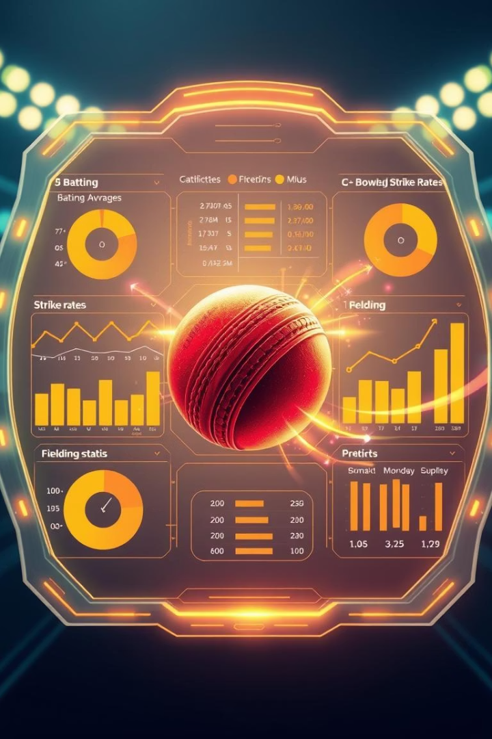
Data Sources and Analysis Approach
Data Sources
Analysis Focus
Used official cricket stats and sports websites for comprehensive data.
Explored metrics like runs, wickets, player performances, and team wins.
Tools Used
Python libraries Matplotlib, Seaborn, and Plotly created clear visuals.

Slide 3

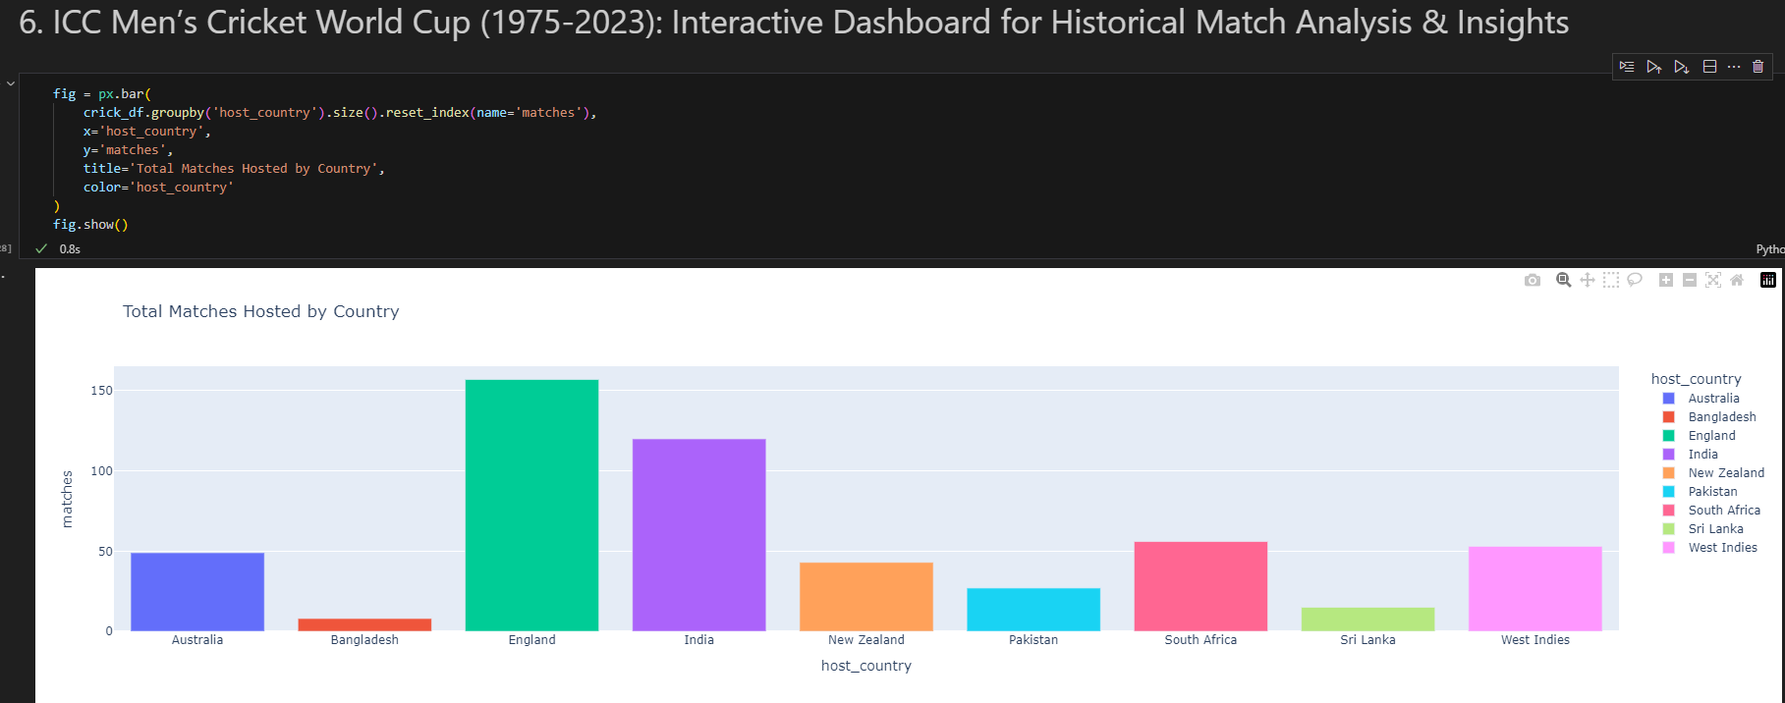
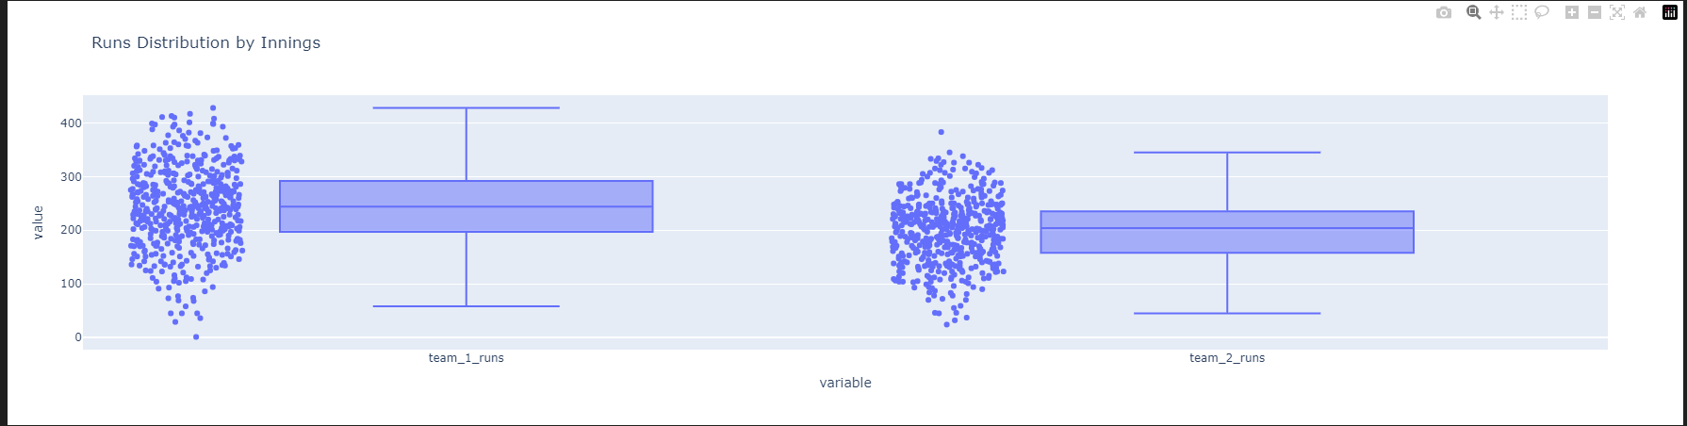
The Rise of Power Hitting
Key Insight
Average runs per innings increased steadily from 2000 onwards.
This indicates a strategic shift toward aggressive batting in ODIs.

Slide 4
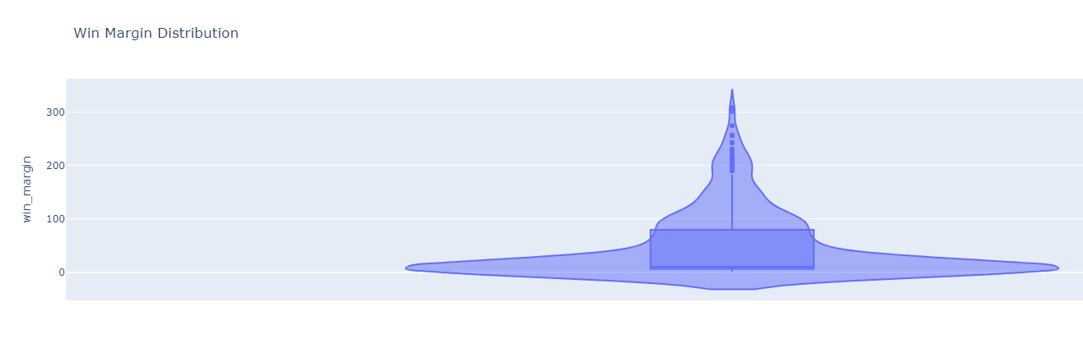
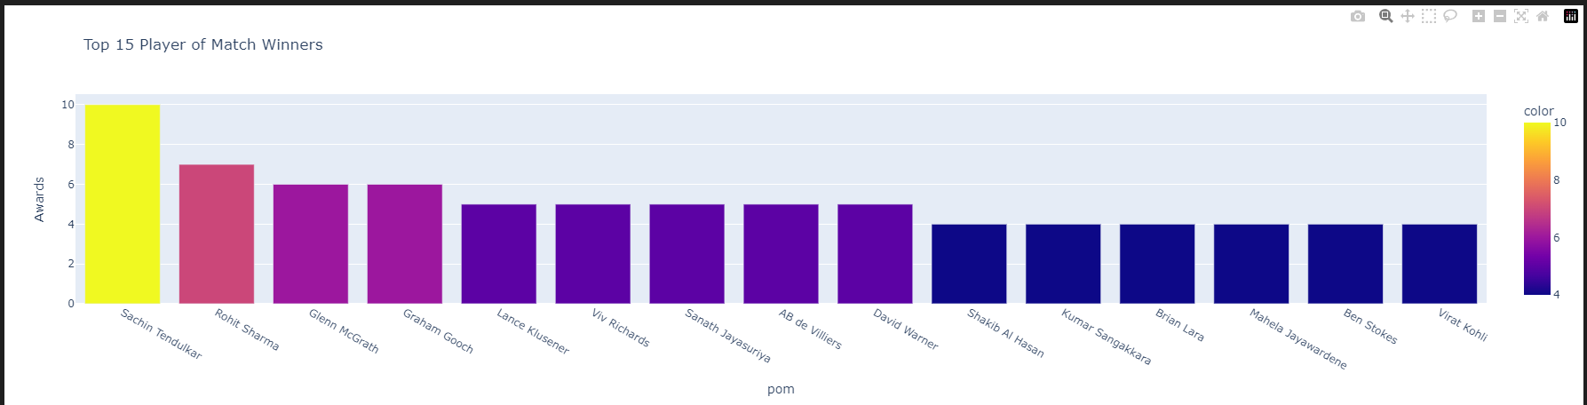
Consistency in Top Performers
Key Finding
A handful of players maintained high performance across multiple tournaments.
Consistency drives team success and tournament impact significantly.

Slide 5

Summary and Looking Ahead
Main Findings
Runs per innings rose steadily indicating aggressive play
Top players’ consistent performance influences outcomes
Data-driven insights reveal evolving game dynamics
Future Exploration
Assess impact of rule changes on game strategies
Analyze career trajectories of emerging stars
Explore home advantage effects in different tournaments

